Slide 1
Should MLCs be more Proactive?
John O’Donoghue
Lisa O’Keeffe
Olivia Gill
Mathematics Learning Centre
University of Limerick

Slide 2
Changing Environment
The changed and changing environment demands a more proactive stance by the MLCs for a variety of reasons related to the drivers of change which are identified as follows…

Slide 3
Drivers of Change
Economic Austerity
Smart Economy
Mass Higher Education
Changing Profile of Entering Students
Project Maths
Other developments

Slide 4
Economic Austerity
Current economic climate
Increase in student numbers
Increase in diversity of backgrounds
Increase in the number of degree programmes being offered
Etc.
Decrease in funding
Cost Effective

Slide 5
The Smart Economy
The smart economy will demand in mathematical terms more people attaining higher levels of mathematics
Professionals in numerate disciplines performing at higher levels which will demand more mathematics.
A more mathematically literate general population is envisaged/demanded
The quality of the numerate professions e.g. the engineers, is more crucially dependent on the quality of the mathematical achievement of the entrants
This will need additional support to be achieved
➔ MLCs!!

Slide 6
Mass Higher Education
Pressure for a more varied profile in mathematics entry requirements
Cause ➔ government policy for mass higher education
Currently 70% of current population
Projected participation of c. 90%.
Only possible through a relaxation of gatekeeping function of mathematics
Implies a more varied profile of entry routes

Slide 7
Traditional Profile of Entering Students
Entry standards traditionally has been very homogeneous from a mathematics point of view
University
Leaving Certificate Higher
Leaving Certificate Ordinary
IOTs
Leaving Certificate Higher
Leaving Certificate Ordinary
Other (Foundation, FETAC, LCAP)

Slide 8
Change in Profile
Impacts in 2 ways:
Preparedness of traditional groups
Arrival of new groups
Mature Students (Leaving Cert)
Mature Students (No Leaving Cert)
Mature Students (Access)
Non-nationals (Mature)
Other
Labour Market Activation
??

Slide 9
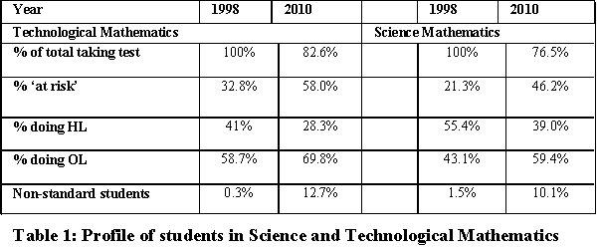
Change in Profile

Slide 10
Different Profiles
Already MLCs are playing a role in creating multiple profiles
Access
Special engineering exams

Slide 11
Project Maths
Project Maths will not make the MLCs redundant…
Why?
Students will enter university with better preparation
Students will be better matched to the demands of higher education
New gaps initially e.g. vectors, matrices
Gaps will persist until mathematics departments respond by reviewing their programme offerings
Low achievers will still require support
Other

Slide 12
How will we be more Proactive?
Business as usual until 2014/15
Anticipate a dip 2012 - 2014
Students making the transition from traditional JC to PM
Anticipate a dip 2015
First PM graduates (1st year – Leaving Cert)
Need to work with mathematics departments to effect review of current offerings in view of gaps
Need to provide topic based workshops or additional online support to fill gaps (in preparation)
Enhanced role for online support (in development)
More active collaboration between MLCs and sharing of resources and insights
Research

